Slide 1
Static & Dynamic Input Multiplexing for High Density Neural Signal Recording
US 2023/0273681, 8/31/2023
3/24/2024

Slide 2
Outline
Goal: Discuss static and dynamic input multiplexing for high density neural signal recording
Embodiments:
Human head with BMI implants
Implants with and without cover
System design
Inputs of Multiplexer
Schematic Diagram of Input Multiplexer
Flowchart

Slide 3
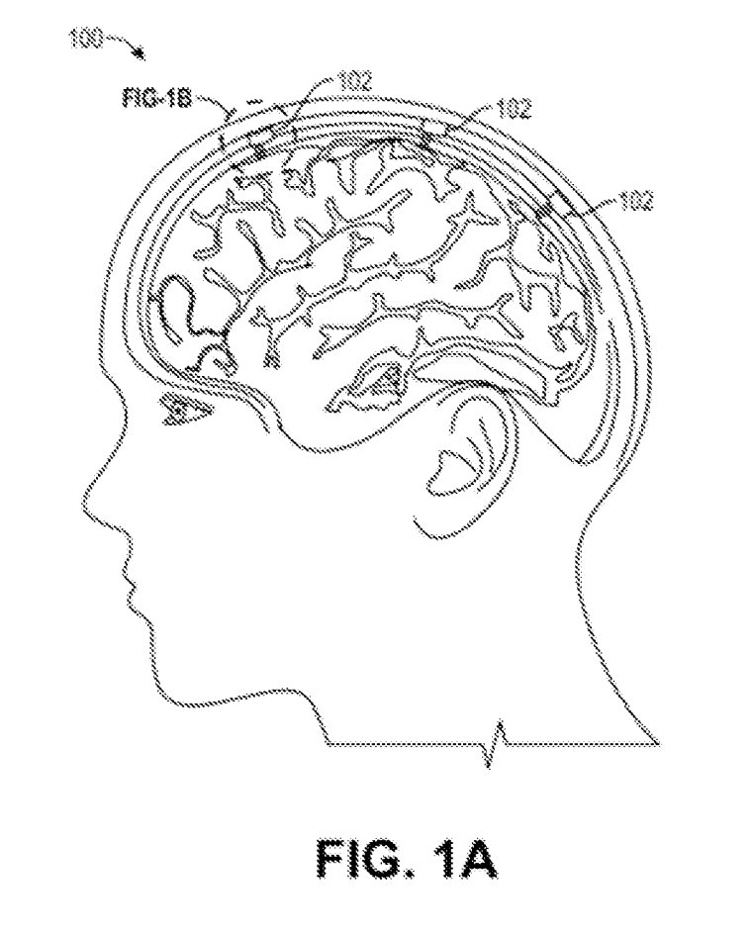
Human head with BMI implants

Slide 4
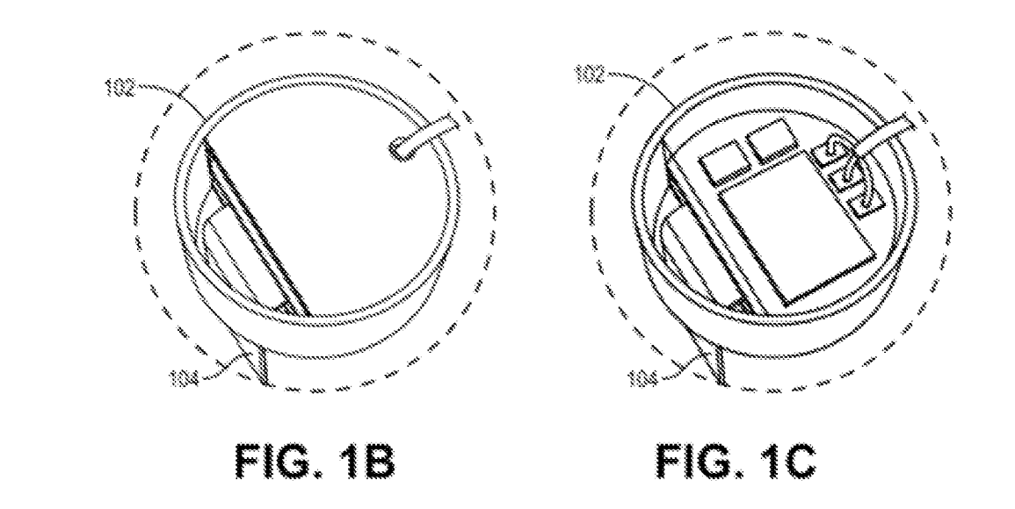
Implants with & without cover

Slide 5
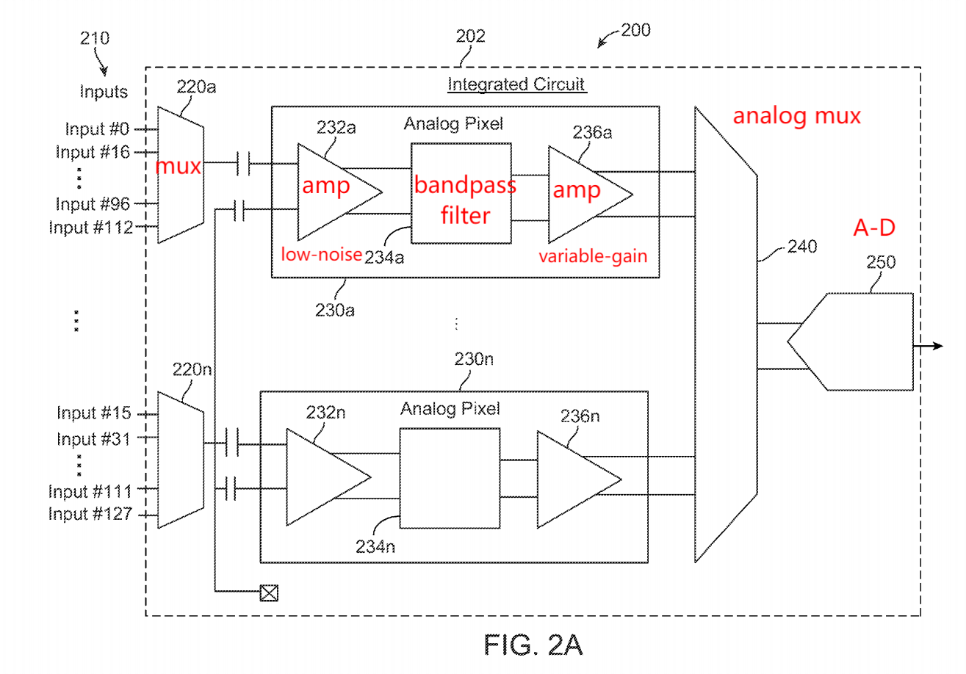
System Design

Slide 6
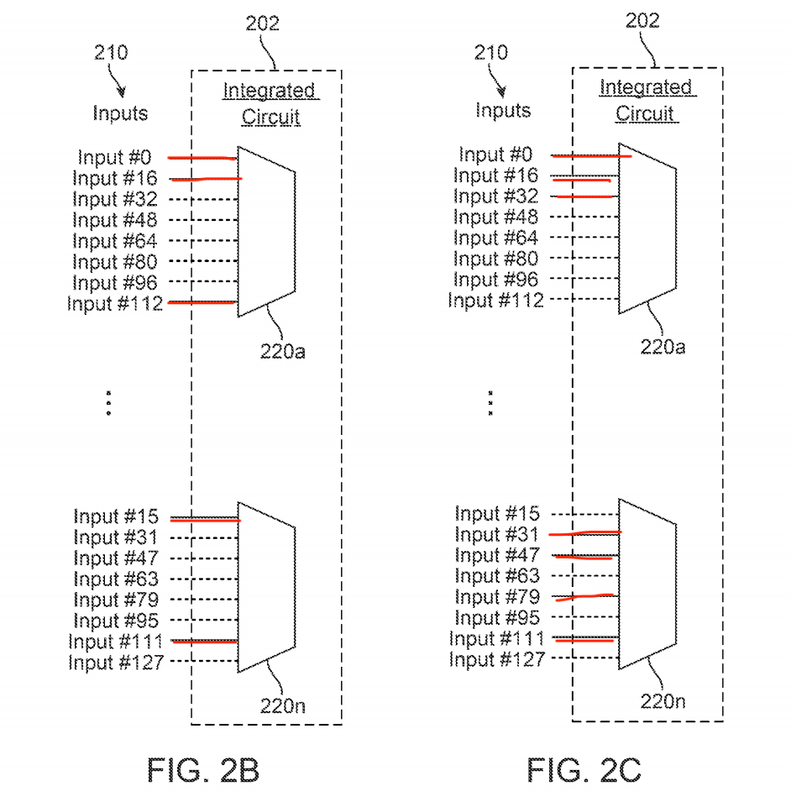
Inputs of Multiplexer

Slide 7
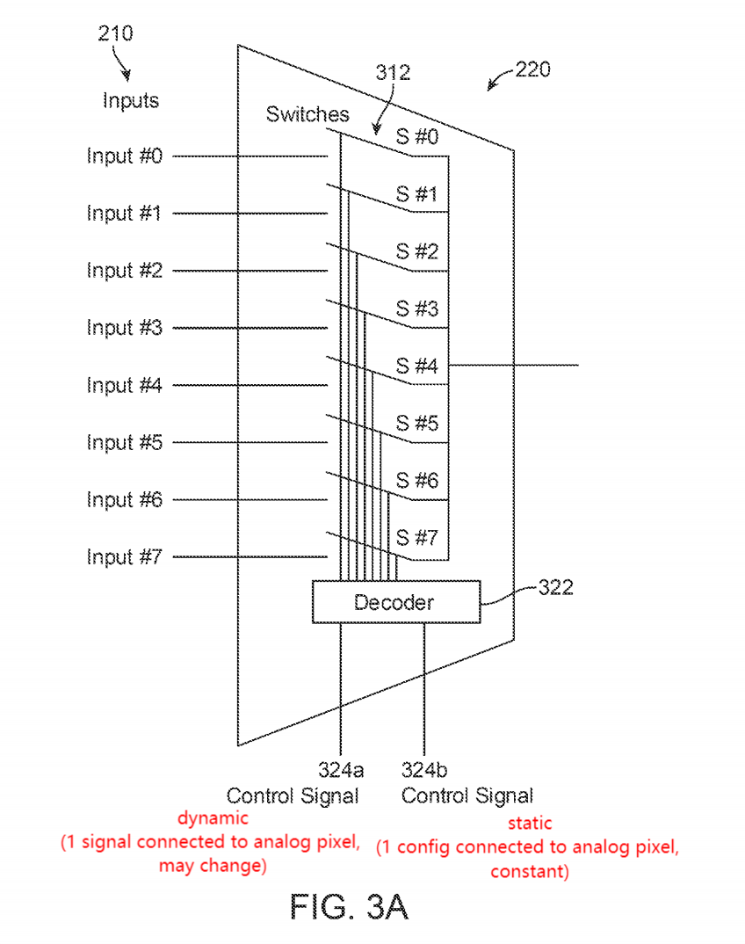
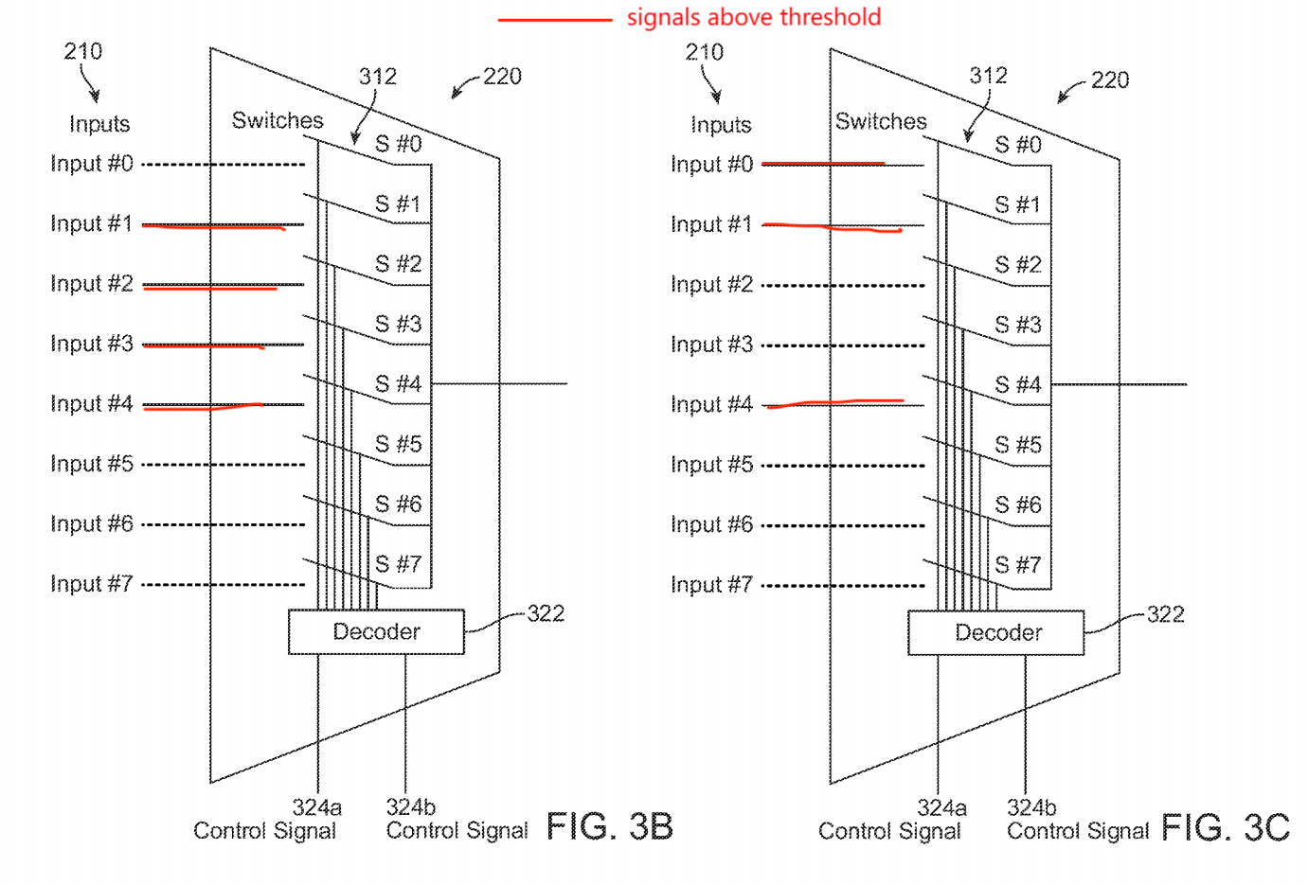
Schematic Diagrams of Input Multiplexer

Slide 8
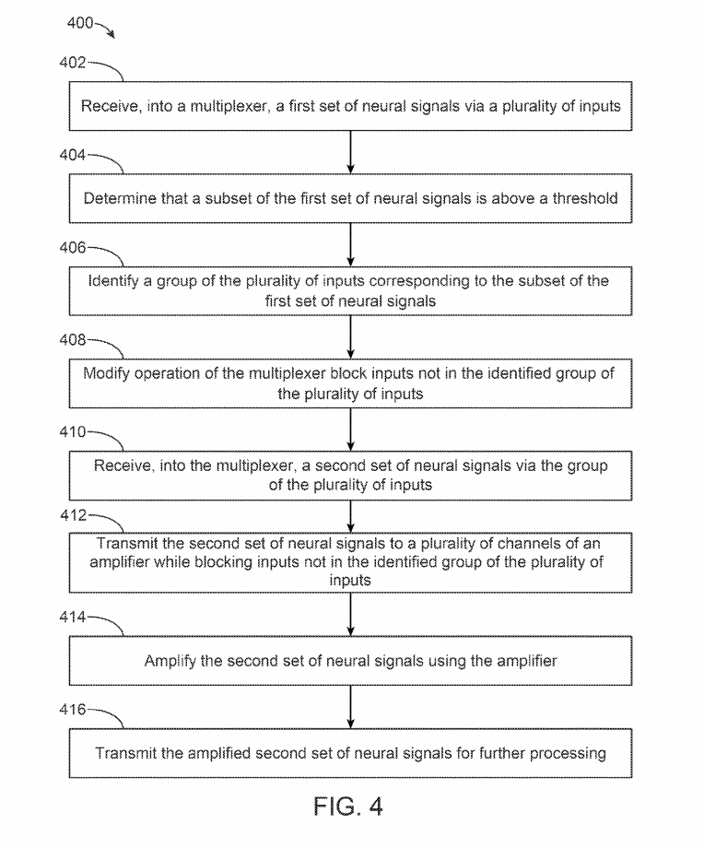
Flowchart

